Slide 1

My Earth
By R.N.B team

Slide 2
OUR APP: My Earth
Fun
Educational
Explorative
.
Notes:
This template was inserted from Power-user, the productivity add-in for PowerPoint, Excel and Word.
Get thousands of templates, icons, maps, diagrams and charts with Power-user. Visit https://www.powerusersoftwares.com/!

Slide 3
Facts:
80% of learners say they would be more productive if their learning was more game like

Slide 4
Our Team Layout
Najoua Boutahar
Rihab Benyane
Najlae Benami
Amine Rajini

Slide 5
GOAL 1:
GOAL 2:
GOAL 3:
Educate people about NASA’s Earth science studies
Learn characteristics, dates and important events of NASA’s Earth science history
Providing simple explanations of complicated NASA’s Earth themed subjects
Notes:
This template was inserted from Power-user, the productivity add-in for PowerPoint, Excel and Word.
Get thousands of templates, icons, maps, diagrams and charts with Power-user. Visit https://www.powerusersoftwares.com/!

Slide 6
Facts:
Research has shown that micro learning improves learners’ performance by 17%

Slide 7
ABOUT
Our app is suitable for a wide and diverse audience range from children to adults of all ages and backgrounds
Our users
OUR PRIORITY

Slide 8


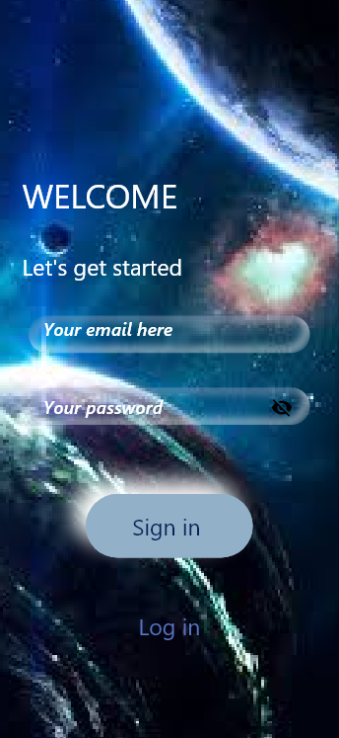

Explore My Earth

Slide 9

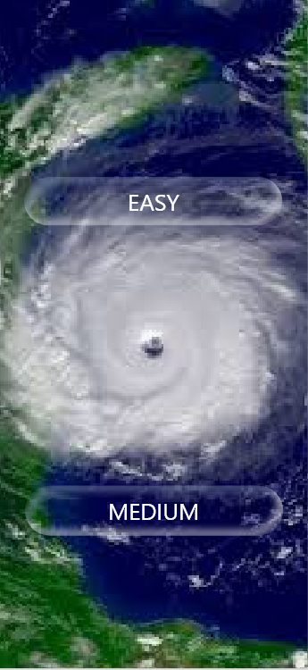
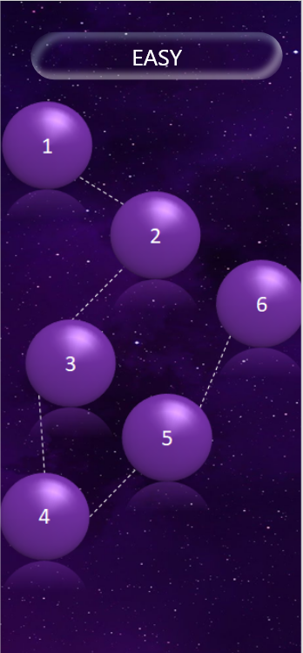

Slide 10
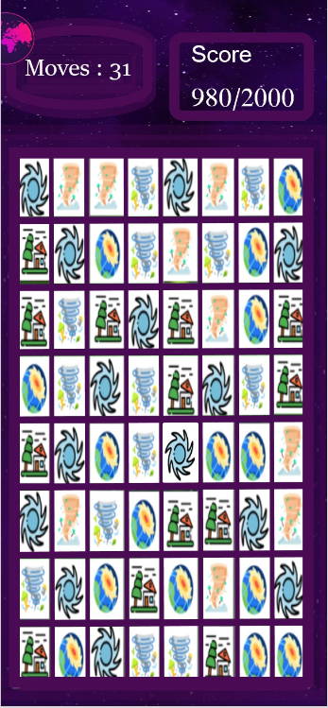
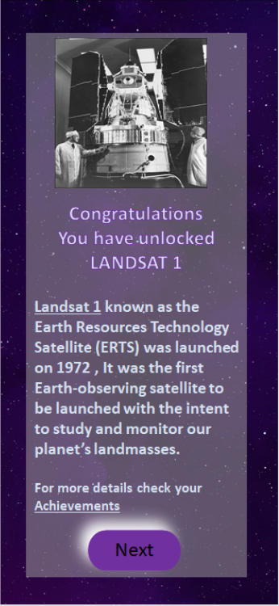
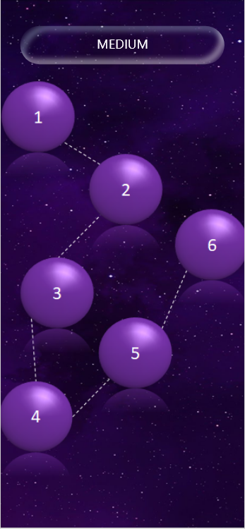

Slide 11
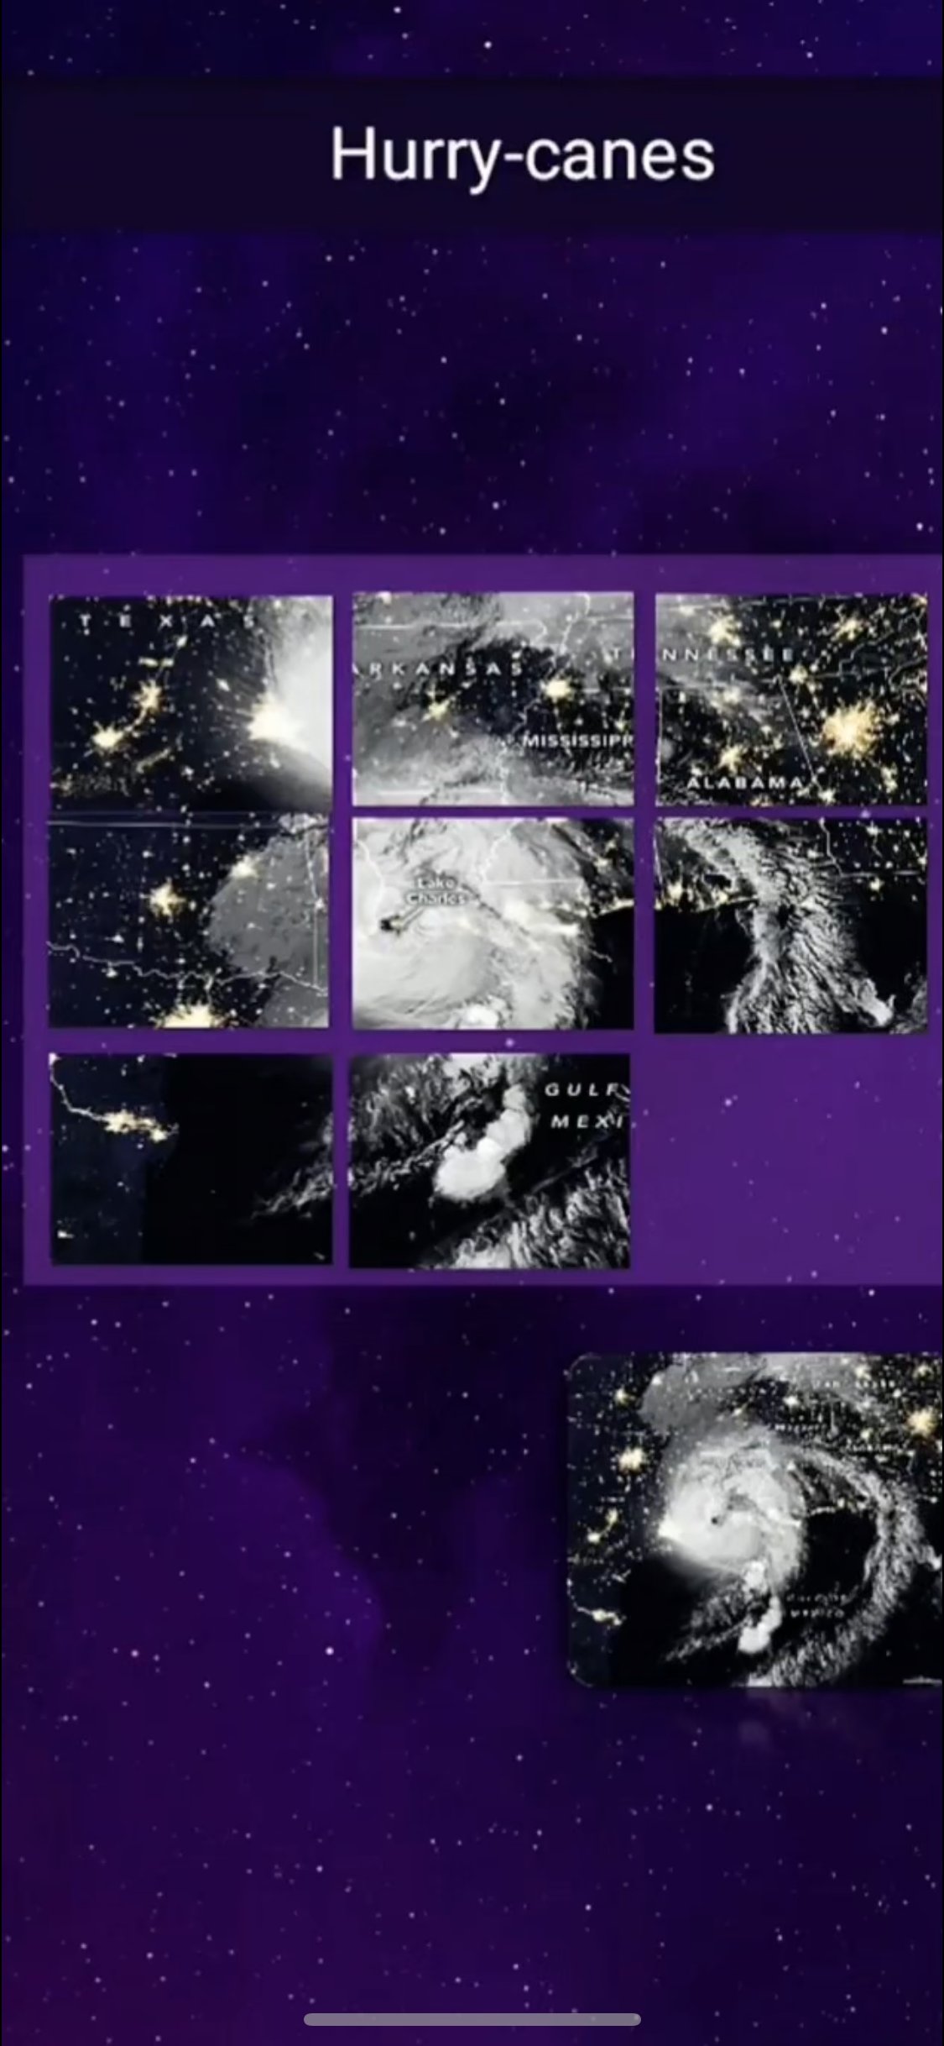
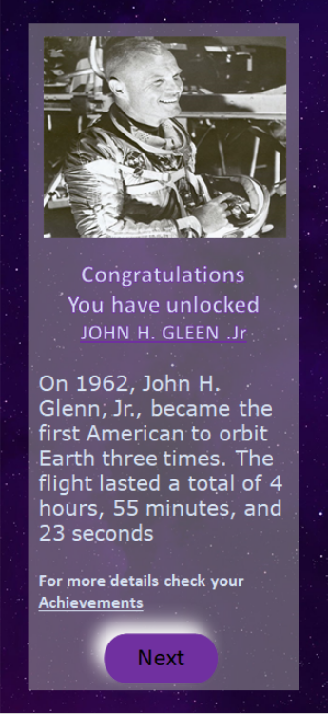
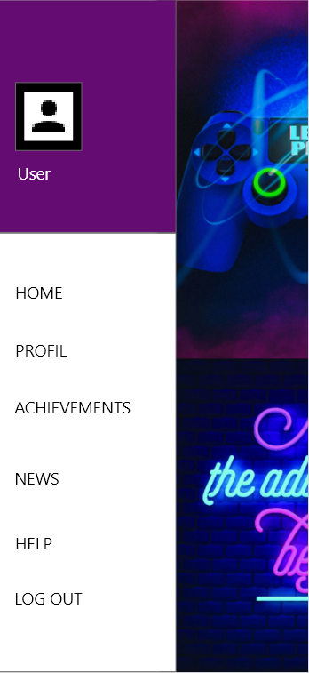

Slide 12
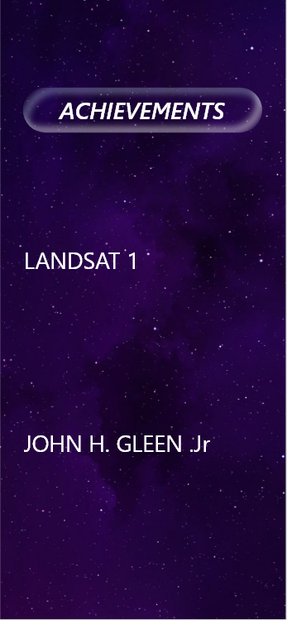
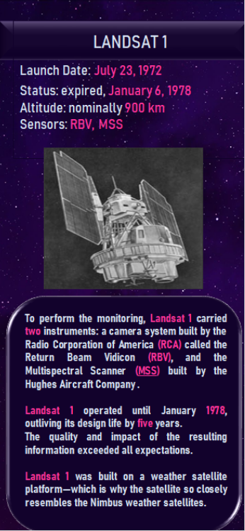
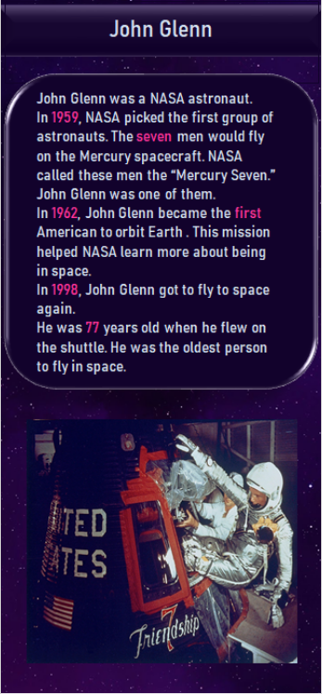

Slide 13
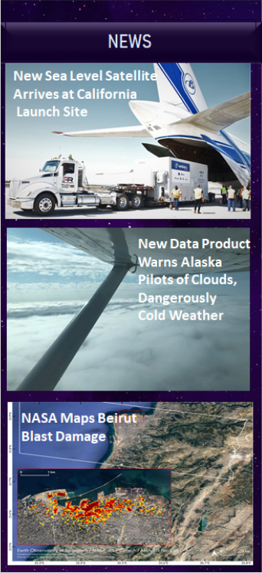
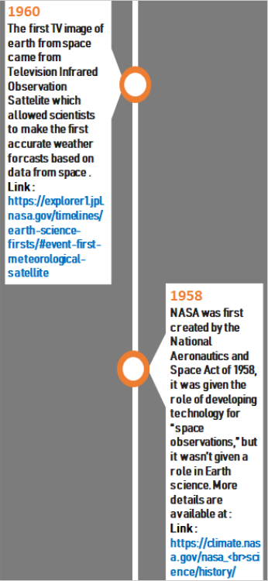

Slide 14
FUTURE UPDATES:
A VR implementation so that the user can discover the inside of the ISS.
A game where the user can create their own phenomena
Short animated videos where the user explores NASA’s history in details
The adventure mode will also give the user the ability to create a virtual volcano and to virtually experience different earthquake magnitudes

